Slide 1
Elasticsearch
For dummies :p

Slide 2
Agenda
Introduction
Elasticsearch
ELK Stack
Samples
Logz.io
Questions

Slide 3
About me
Hey, I’m Ori Riechman.
I’m from Israel, 26 years old. I have over 10 years software development experiences of information systems - client and server.
Graduated Bsc. Computer science in 2015

Slide 4
Introduction

Slide 5
When to use Elasticsearch
You run a web store where you allow your customers to search for products
You want to collect log or transaction data and you want to analyze and mine this data
You have analytics/business-intelligence needs and want to quickly investigate, analyze, and visualize on a lot of data
You run a price alerting platform

Slide 6
Elasticsearch

Slide 7
Elasticsearch
Open source: Apache licence 2.0
Document-based, Dynamic schema
REST & JSON
Search Driven Design
Based on Lucene

Slide 8
Basic Concepts
NRT - Near Realtime
Cluster
Node
Index
Type
Document

Slide 9
Distributed search engine
Sharding
Split logical data over several machines
Write scalability
Replication
Read scalability - Load balancing
Removing SPOF

Slide 10
Distributed
Node 1
curl -XPUT ‘http://localhost:9200/orders/’ -d ‘{
“settings” : {
“index” : {
“number_of_replicas” : 1,
“number_of_shards” : 4
}
}
}
curl -XPUT ‘http://localhost:9200/products/’ -d ‘{
“settings” : {
“index” : {
“number_of_replicas” : 0,
“number_of_shards” : 2
}
}
}
Orders
1
2
3
4
Products
1
2

Slide 11
Distributed
Node 1
Node 2
Orders
Orders
1
2
1
2
3
4
3
4
Products
Products
1
2

Slide 12
Distributed
Node 1
Node 2
Node 3
Orders
Orders
Orders
1
2
2
1
4
3
3
4
Products
Products
Products
1
2

Slide 13
Search by query string
Terms apple
Phrases “iphone apple”
Proximity “apple safari”~5
Fuzzy apple~0.8
Wildcards *pp*
Boosting apple^10 safari
Range [2016/01/01 TO 2016/12/31] OR [java TO json]
Boolean (apple OR iphone) AND NOT review
Fields title:iphone^15 OR body:iphone

Slide 14
Search by JSON-based DSL
GET /tweeter/tweets/_search
{
"size" : 30,
"query" : {
"bool" : {
"filter" : {
"range" : {
"@timestamp" : {
"from" : 1470074038203,
"to" : 1470765238203,
"include_lower" : true,
"include_upper" : true
}
}
}
}
}
}

Slide 15
Aggregations
Buckets
terms
range
geo_range/geohash_grid
date_histogram
Metrics
count/sum/avg/min/max
top_hits
cardinality
percentiles

Slide 16
The ELK Stack

Slide 17



The ELK Stack
Logstash
Streaming data digestion
Time normalization
Field extraction
Elasticsearch
Schema-less search DB
Highly scalable
Kibana
Visualization

Slide 18

ELK in numbers
#1 in user adoption
#1
ELK has more companies using it than all other proprietary tools combined
500K
102
500K monthly downloads
102 meetup groups

Slide 19
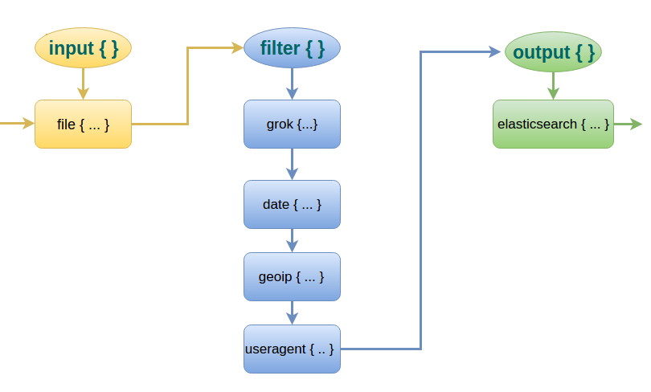
Logstash

Slide 20
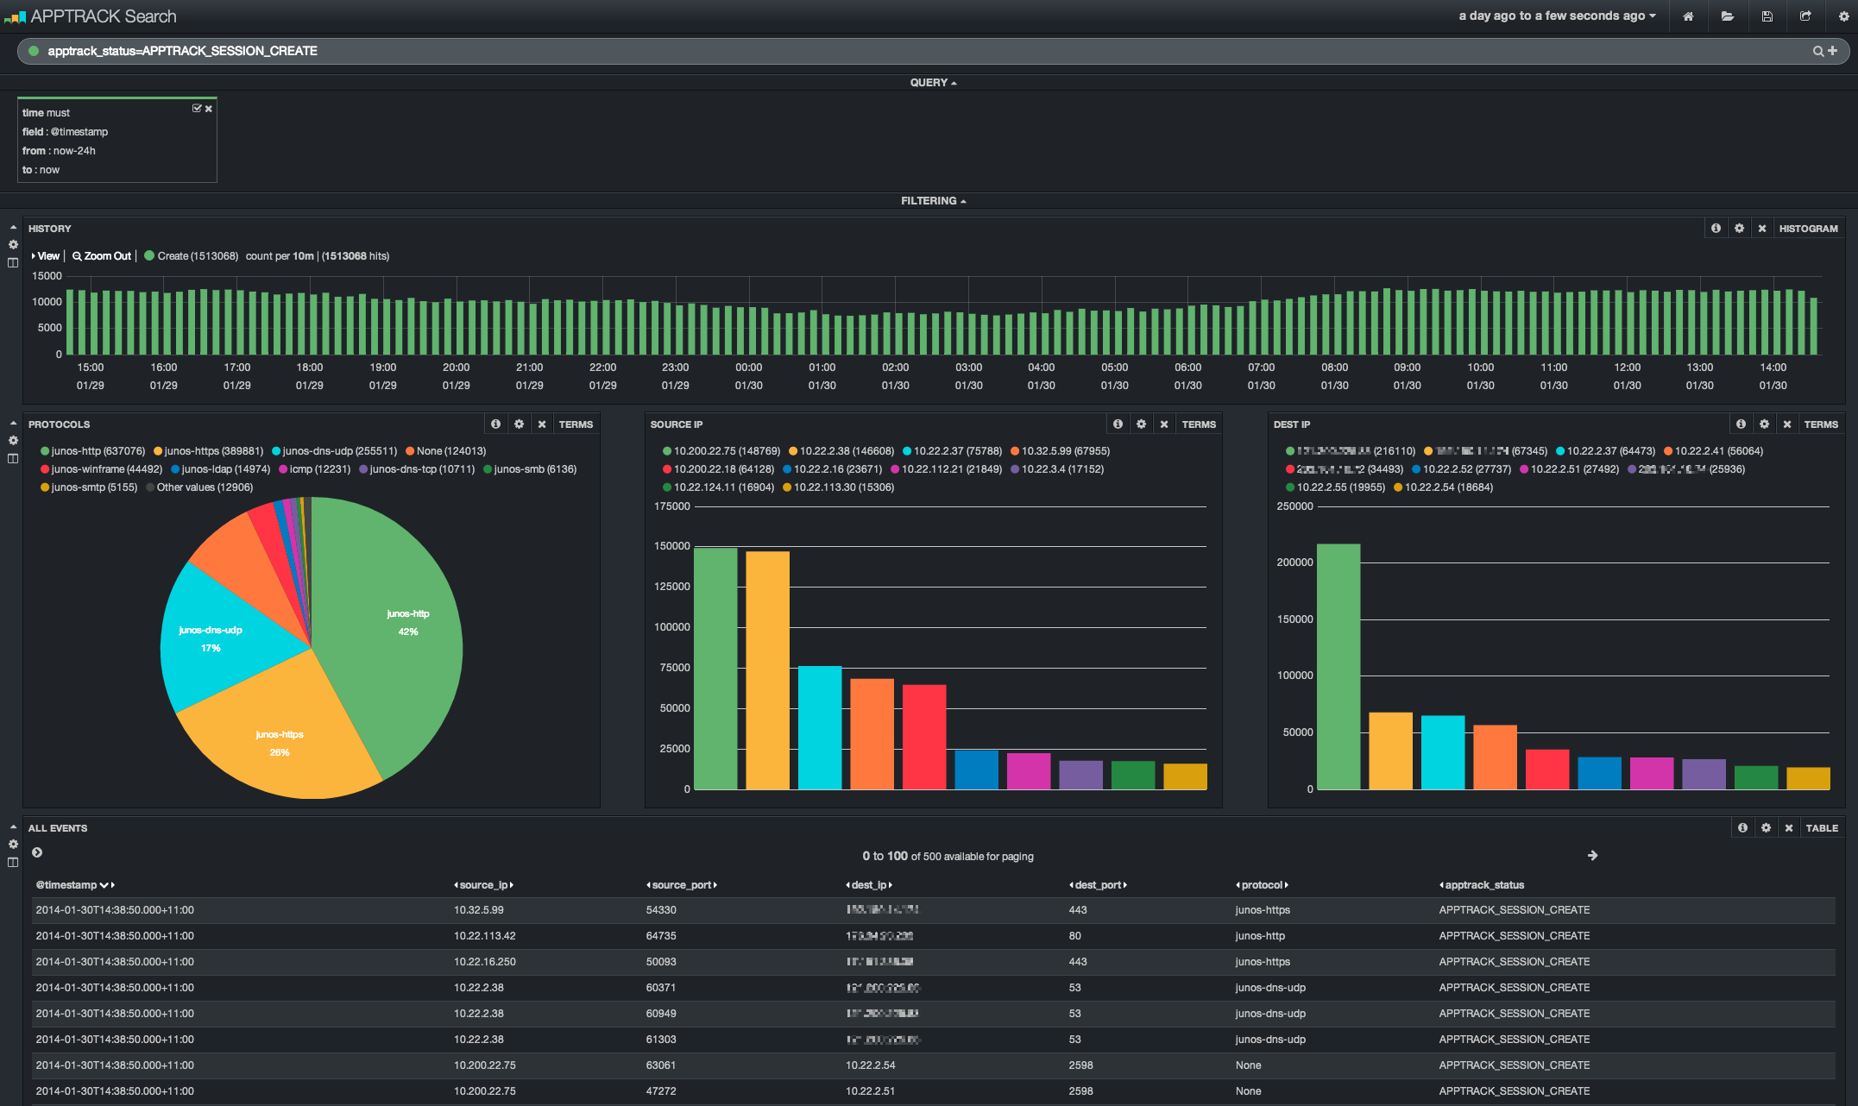
Kibana

Slide 21
Samples

Slide 22
Logz.io

Slide 23
Our Architecture
Monitoring: ELK, NewRelic, Nagios etc.
Ha Proxy
Listener
Kafka
Log Engine
Elasticsearch
Cluster Protec-tion
Play server
Listener
Logstash
Listener
Log Engine
Listener
Shard optimizer
Kibana
S3
Alert Engine
DLQ
Curator
Hot/Cold migration
API Gateway

Slide 24
Demo

Slide 25
Questions?

